Slide 1
How Splunk Manages Our Junk
Our experiences throughout the
3 year journey

Slide 2
About us
Harvard University – University Network Services Group
Serving over 2500 faculty and more than 18,000 students
Jim Donn Management Systems
Architect and implement Management solutions
Deliver fault notifications
Previously with HSBC
13 years in IT from NOC -> Sr. Engineer
Tim Hartmann Systems Administrator
Architect and implement Authentication solutions
Troubleshoot various server related issues
Previously with another division within the University
11 Years in IT from Help Desk -> Sr. Engineer
Notes:
Jim = Monitoring app guy
Tim = Systems admin

Slide 3
Our Interests
Share our experiences with others
Collaborating with like minded people
Discuss strategies to tackle common issues
Share solutions / code
Endorse community activity!
Notes:
Community
Collaboration
We do not work for Splunk.

Slide 4
Day 0
Network and Systems team have very similar needs – centralized logging.
Teams belong to the same department, but historically act independently.
2 independent Syslog-NG implementations.
Jim and Tim break the mold and talk to each other!
Notes:
We were very silo’ed groups
Our collaboration was contagious, more wanted to join in as they saw our results.

Slide 5
Network Management Systems Drivers
New tools must scale with the rebuild of Enterprise Network Management Systems
Syslog needs:
Syslog aggregation
Reliable event forwarding
Easy to use web interface
Centralized log viewer
Correlation and alerting engine*
Notes:
Very simple needs, we end out going much further.
We had nothing the day that I started, syslog-NG was a big step forward for our team

Slide 6
Systems Team Drivers
Need to track down and resolve issues faster
Syslog needs:
Centralized logging
Web based search viewer
Role based access to logs
Alerting
Reporting
Trend Analysis
Notes:
More more grepping through 5 GB files. No longer searching on several devices when troubleshooting.

Slide 7
How to get data into Splunk?
UDP / TCP forwarding
Agents
Watch file
Watch folder
WMI / Event Log / Registry data
Scripted inputs *
Notes:
We went with what we knew at the time – keeping it simple.

Slide 8
Evaluation
Tim leads Splunk evaluation, sets up server
Simple installation
Tim and Jim point Syslog-NG envs at Splunk
Develop User Roles strategies
Net Eng, NOC, Security, and Server teams
Develop data separation strategies (KISS)
Host names
Sourcetypes
Indexes
Notes:
Quick, easy, painless. From Tim’s condo.

Slide 9
Installation stats
400 Linux, Solaris, and Windows servers
700 Switches and Routers
2300 Wireless Access Points
TACACS+ authentication logs
VPN access logs
DNS and DHCP logs
50 registered Splunk users, half are regular users
Notes:
We have doubled our count stats, but our license usage increased 100 fold.
Discuss licensing and sizing.

Slide 10
Phase 1 Hardware and Strategies
What it runs on
Strategies
RHEL 5 – 64 bit
Commodity HW
15k local disk
RAID 5 1.6T
2 x 4 Core Processors (3.00 GHz)
16 GB RAM
Custom Yum Repo for software Deployment
Two of everything
Fast disk
Wherever possible we made our configurations independent of other services (SAN/NAS)
Simplicity keeps it maintainable
Notes:
Everything on two servers. Later we upgrade our architecture as we outgrow this one.

Slide 11
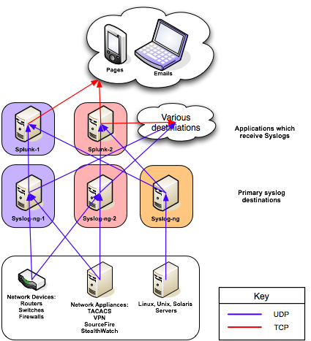
Phase 1 – Basic syslog, “just get it in”
Very few agents
All UDP
Sourcetype based roles
Dual role servers (search & index)
Hot / Hot HA architecture
1.6 Terabytes of useable disk each
Splunk v 3.x
Notes:
NO AGENTS, UDP, forwarding from two syslog-NG servers

Slide 12
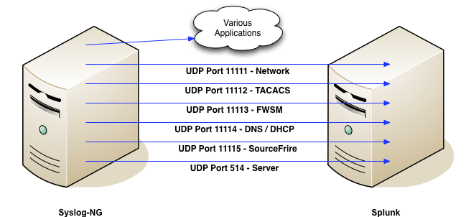
Closer look at Syslog-NG
Notes:
Source based UDP data separation in early stages. Our strategies grow with the application.

Slide 13
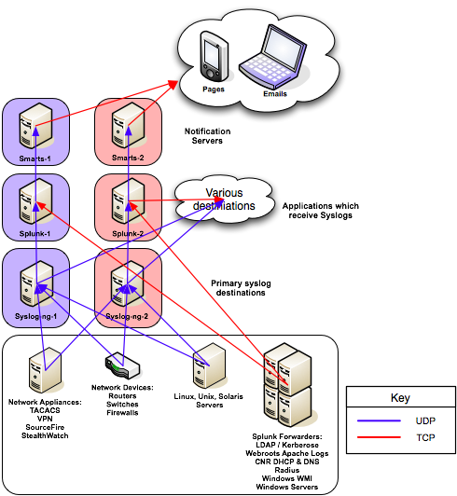
Phase 2 – More logs!
Merge Syslog-NG servers
Start to introduce more Splunk agents to grab difficult logs
Add more departments
Splunk integrated with event notification path
Replaces syslog adapter
in EMC Smarts
Splunk v 3.x
Notes:
Teams are fully committed, we start sharing more infrastructure.
Agents are proving to be very useful.
We begin to replace parts of Smarts.

Slide 14
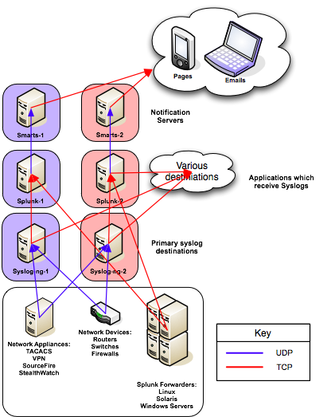
Phase 3 – Agents and Indexes
More and more Splunk agents
Windows servers migrated
TCP forwarding of syslogs
Multiple indexes
Index based roles
Faster searches
Replace Smarts DB with
Splunk
Hardware is now available for Splunk expansion
Splunk begins to fill monitoring gaps, acts as “glue”
Splunk v 4.x
Apps now available
Free Unix & Windows Apps
First round of developing our own
Notes:
Agents on Winders – our single agent collection server was not working out.
TCP forwarding!
More agents enable us to retire Smarts DBs! We repurpose the hardware for more Splunk indexers.
Agent log scraping becomes the “glue” to bond custom monitoring solutions into a single search view

Slide 15
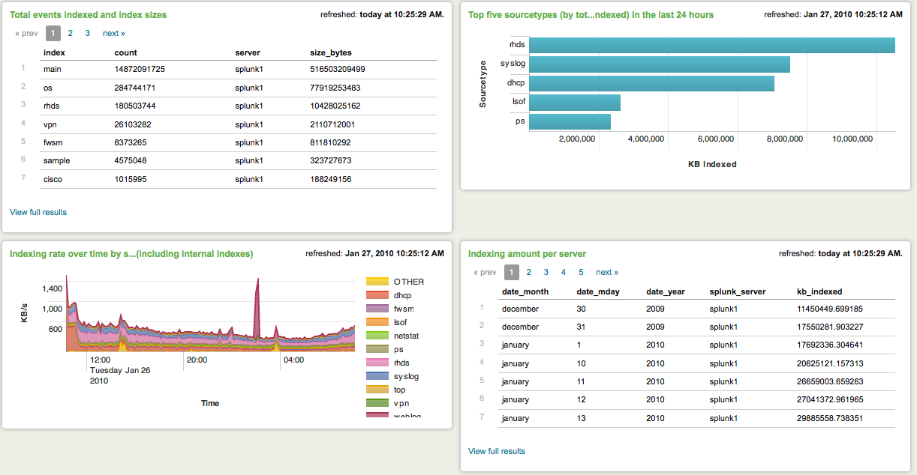
Snapshot after implementing more indexes
Notes:
Immediate speed increase is noticed with multiple indexes

Slide 16
Splunk growth around the same time
Organic growth with other departments
Steady growth of indexed data
Introduction of new indexes
Security mandate to have Splunk on all servers
Notes:
Need to upgrade our license from 20GB -> 50GB

Slide 17
Phase 4 Hardware and Strategies
What new Indexers runs on
Strategies
RHEL 5 – 64 bit
Commodity HW
15k Direct Attached Array
RAID 5 1 TB
Room for more drives
2 x 4 Core Processors (3.00 GHz)
12 GB RAM
Custom Yum Repo for software Deployment
SVN for application management
Horizontal expansion
Search Heads
Two of everything
Keep the hardware specs close as possible
Fast disk
Use of Linux LVM to grow additional disk
Wherever possible we made our configurations independent of other services (SAN/NAS)
Simplicity keeps it maintainable
Notes:
Our new architecture includes horizontal expansion / map reduce
SVN for app control

Slide 18
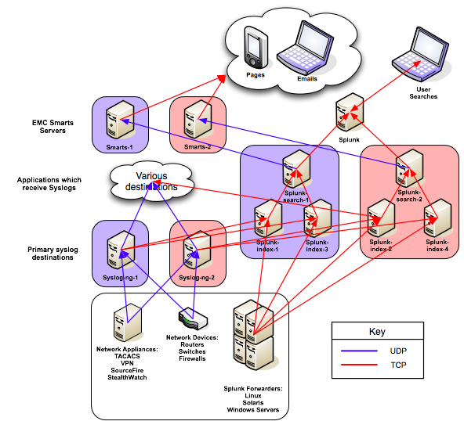
Phase 4 – Apps and Security
Migrate unified alerting
Remove UDP everywhere possible
New Splunk Architecture!
Horizontal expansion (map reduce)
Search Heads
Scheduled search server
Automated sync
More disk!
Load balanced VIP?
Agents, agents, agents
Support for apps
Custom inputs
Scripted output
Splunk Agent on Syslog-NG
Deployment Server
Notes:
Change direction with centralized alerting – much will be custom work, HA reduction of notifications
Agents remove UDP where ever possible
Deployment server necessary to manage configs on servers that we are not administrating

Slide 19
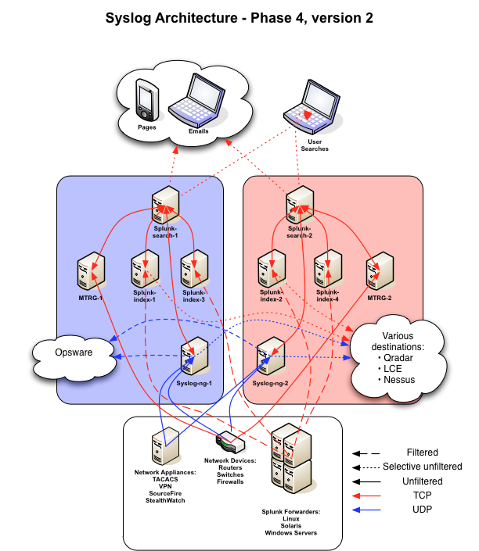
Phase 4, v. 2 - Apps
Same as v. 1 but…
Collapse Apps into Splunk infrastructure:
MRTG?
Syslog-NG?
Splunk-data-gatherer hybrid?
Deployment Server:
Use Puppet
Use SVN
Notes:
Collapse all apps that we can – NetFow is the other standalone

Slide 20
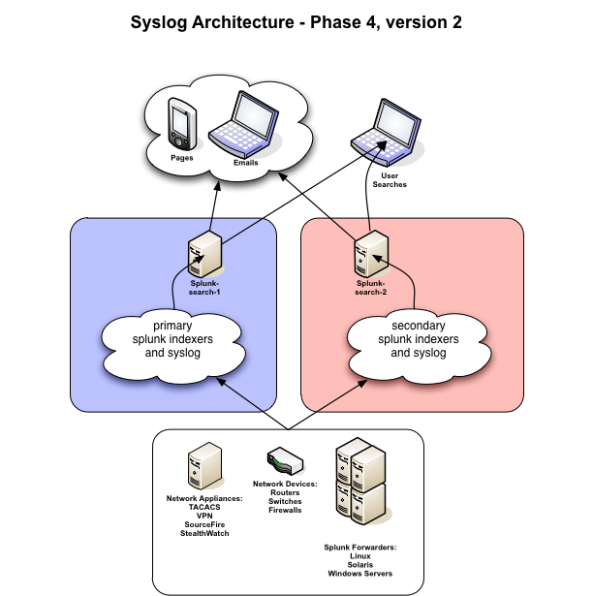
From a users perspective
Search heads have access to all indexers:
Two of everything for automatic redundancy
Notes:
Users do not need to know what is behind the curtain.
Same is true for Splunk application developers - Security

Slide 21
Home Brewed Splunk Apps / Usage
Xen server status
Replace legacy monitoring scripts
Transaction based alerts for Linux and Windows
Scripted inputs provide visibility into Network device port status (CLI only data)
Mac Address tracking
Notes:
Sever team moved first with dashboards
Network team as happy to have alert

Slide 22
Track-A-Mac
Notes:
My laptop – there is an App for this. Spent an hour trying to config.

Slide 23
Additional info
Contact info
james_donn@harvard.edu
tim_hartmann@harvard.edu
Community
http://answers.splunk.com
https://listserv.uconn.edu/cgi-bin/wa?A0=SPLUNK-L

Slide 24
Search assistant

Slide 25
Search assistant

Slide 26
Documentation is great!

Slide 27
Development Stages
GUI Application builder
Too Easy
Simple XML
Just about right
Advanced XML
You are committed
Notes:
Apps are self contained
Several apps can look at the same data!
There are a bunch out there
Easy to steal what you like, and I encourage it

Slide 28
GUI Application builder

Slide 29
GUI Application builder

Slide 30
GUI Application builder

Slide 31
Simple XML

Slide 32
Simple XML

Slide 33
Simple XML

Slide 34
Advanced XML

Slide 35
Help = UI Examples App

Slide 36
Future Apps
Security App
Requirements TBD
Manager of Managers
Net-SNMP trap receiver
Migrate MRTG graphs (Non-RRD)
Replace Cacti (RRD)
Trend all SNMPoll and d3m0n data

Slide 37
MoM – Fault Management

Slide 38
MoM – Fault Management

Slide 39
MRTG in Splunk
MRTG – legacy non-RRD
Splunk

Slide 40
This happened Tuesday…

Slide 41
This happened last Thursday!

Slide 42
This happened last Thursday!

